Slide 1
Antibacterial Drugs
Drugs that generally treat Gram + bacteria
Glycopeptide Vancomycin
Nitro Imidazoles Metronidazole
Lincosamide Clindamycin
Cyclic Lipopeptide Daptomycin
Oxazolidine Linezolid
Streptogramin Quinupristin/dalfopristin (Synercid)
Drugs that generally treat Gram - bacteria
Fluoroquinolones
Aminoglycosides
Polymixin
Drugs that Treat UTI
Folate antagonists
Nitrofurans
Other
Macrolides and ketolide
Tetracyclines and glycylcycline

Slide 2
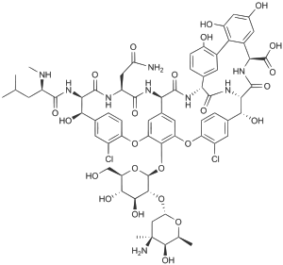
Glycopeptide
Drug: Vancomycin
MOA: inhibit cell wall synth
Treat: All gram (+) except those resistant to it: VRE
DOC: MRSA
DOC: PO used only for severe Clostridium difficile
VRE (vancomycin resistant enterococci): E. faeciUM
ADR
Red Man syndrome
nephrotoxicity
Ototoxicity

Slide 3
Nitro imidazole
Drug: Metronidazole
PK: 90% absorbed in all tissues → elim hepatic, renal and recirculated
Treat: Clean up organisms that the big drug classes, pen, ceph, fluor, macro miss
parasitic infections such as Trichomoniasis Vaginalis (STD)
Abdominal Gram (+) anaerobes. DOC for C. difficile colitis
ADR
D-D with warfarin
Disulfiram reaction, with pts taking alcohol

Slide 4
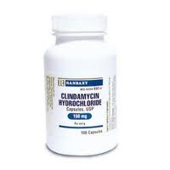
Lincosamide
MOA: protein synthesis inhibitor 50S
PK: high distribution
Drug: Clindamycin
Mix of Vancomycin + Metronidazole
Vancomycin: MRSA
Metronidazole: Abdominal Gram + anaerobes. DOC for C. difficile colitis
Treat: “clean up” all of the anaerobes
DOC skin and soft tissue MRSA
Used topically in the treatment of acne (Propionibacterium acnes)
Gram positive anaerobes
Plasmodium Species (malaria)
ADR
Diarrhea → high risk getting C. difficile

Slide 5
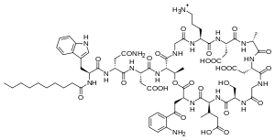
Cyclic Lipopeptide
Drug: Daptomycin (IV only)
PK: elim renally. Check renal function
even though it penetrates lung tissue well → it does not work b/c of surfactants in lungs
MOA: weakens cell allowing ions to leak out of organism → death
Treat: Toxicity is time dependent.
skin and soft tissue MRSA,
Streptococci
Right sided staphylococcal endocarditis
moderate for VRE
ADR:
rhabdo (check CK, creatine)
Notes:
Dap, depolar

Slide 6
Oxazolidine
Drug: Linezolid
Treat: resistant Gram (+) use for pts with < 2 weeks therapy
VRE
MRSA (excellent BA and broad gram + activity)
Multidrug resistant S. pneumoniae
Pros
Broad gram + activity
high bioavailability
eliminates renally and hepatically → no need to dose adjust
Cons
$$$$$
ADR:
If > 2 weeks, Linezolid will inhibit mitochondria in humans → peripheral neuropathy
If > 2 weeks → Bone marrow suppression
D-D interaction. Inhibit MAO-I → Serotonin Syndrome
Notes:
Line → arms & legs → bone marrow suppression
Line → nerves = peripheral neuropathy

Slide 7
Streptogramin
MOA: protein synthesis 50S → given together = bacteriocidal
Drug: Quinupristin/dalfopristin (Synercid)
Treat: Used to be used in VRE (no so much b/c of newer agents)
MRSA not tolerant to other drugs
Enterococus faeciUM (not faecalis) not tolerant to other drugs
Mix with D5W not NS
ADR:
50% chance of myalgia (that’s why it’s not used often)
arthralgia: Painful inflammation and stiffness of the joints

Slide 8
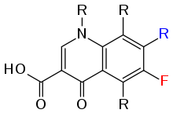
Fluoroquinolones
Drug: Ciprofloxacin, levofloxacin, moxifloxacin, gemifloxacin
PK: well BA, distribution is high such as CNS and heart (check ADR)
Treat:
Ciprofloxacin: enteric GNR (pseudomonas) – E. coli, proteus, klebsiella
Moxi, Gemi: DOC for Strep. Pneumoniae, enteric GNR
Levo: GNR (Pseudomonas) + Strep Pneumoniae
ADR
Review dosing in pts with renal dysfunction (except moxifloxacin which is hepatic)
Prolonged QT (especially moxifloxacin)
CNS adverse reactions such as dizziness, confusions and insomnia, seizures
Contraindicated in pregnant women
Contraindicated in children b/c of cartilage damage
Chelating
Photosensitivity
FLUoroquiolone = FLU = pnehumo
exCept Cipro
Indication | Cipro | Levo | Moxi | Gemi
Systemic Gram (–) infection | + | + | +
Intra abdominal infection | + | + | +
Single dose gonorrhea | + | +
UTI | + | + | NOT MOXI
Pseudomonas | + | + | - | -
CAP, sinusitis, AECB | - | + | + | +
Skin infection | - | + | + | +
Notes:
AECB: = Acute Exacerbation of Chronic Bronchitis
CAP = Community Acquired Pneumonia
Respiratory fluoroquinolones aka Antipneumococcal treat community pneumonia: moxi and gemi
cipro

Slide 9
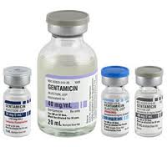
Aminoglycoside: http://www.gentamicin.com/
Drugs: Gentamicin, tobramycin, amikacin, neomycin, Streptomycin (topically in neosporin)
MOA: protein synthesis inhibitors of mRNA → bactericidal
PK: bad distribution. IV only (does not get absorbed PO)
eliminated renally. Check ADR
Treat:
Gram negative: Pseudomonas, Acinetobacter, E. coli and Klebisella domonas
Treat Pseudomonas potency Amikacin > Tobramycin > Gentamicin
febrile neutropenia, sepsis, exacerbation of cystic fibrosis and ventilator pneumonia
ADR:
Narrow therapeutic index
Nephrotoxicity. Monitor trough concentrations
Ototoxicity (monitor hearing and balance)
Pregnancy D
Notes:
Gentamicin, Tobramycin, Amikacin (anti pseudomonal A>T>G)

Slide 10
Polymyxin: not used as much anymore b/c of aminoglycosides
Drug: Colistin
Treat: Last Line multi drug resistant GNR
pseudomonas aeruginosa
Acinetobacter baumannii
Klebsiella pneumoniae
ADR: nephrotoxicity* b/c of tubular necrosis

Slide 11
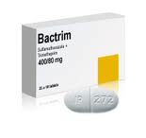
Folate Antagonist
Drug: Trimethoprim/sulfamethoxazole (TMP/SMX) aka Bactrim
MOA: inhibit folate synthesis → no DNA
Treat:
DOC: uncomplicated lower UTI
DOC: pneumocystosis jiroveci: pneumonia, fungal infection of the lungs.
Staph a. (including some MRSA)
H. influenzae: Lower respiratory tract infection
Stenotrophomonas maltophilia: colonizes in endotracheal or tracheostomy tubes,
listeria: eating food contaminated with the bacteria
toxoplasma gondii: protozoa found in immunocompromised cats
ADR:
1. Renal: may cause true renal and pseudo-renal failure (normal creatine: 0.6 – 1.2 mg/dL)
(pseudo = block creatine secretion)
2. Allergy to Sulfa
3. don’t use if pregnant
4. Rash, especially in pts with HIV
5. D-D with warfarin

Slide 12
Nitrofuran
Drug: nitrofurantoin (MacroBID)
PK: well absorbed but not well distribution. Concentrated in Bladder, NOT KIDNEY
(TMP/SMX is concentrated in kidney more)
Treat: alternative for pts who have community aquired E. coli UTI
DOC Uncomplicted cystitis (NOT pyelonephritis) b/c it’s not concentrated in kidney
ADR:

Slide 13
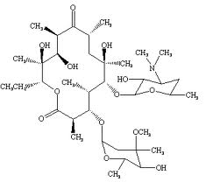
Macrolides
Drug: Azithromycin, clarithromycin, Erythromycin
MOA: protein synthesis inhibitors, inhibiting 50S subunit → bacteriostatic
Treat: Slightly wider Spectrum than Penicillin. Used when pt is allergic to Penicillin.
used most often in outpatient setting b/c of broad coverage of respiratory pathogens
(-) Haemophilus influenzae (lower respiratory tract)
(-) Moraxella catarrhalis (lower respiratory tract)
(+) Strep pneumonia (not that effective due to 30% resistance)
(-)helicobacter pylori (peptic ulcer disease)
mycobacterium avium
chlamydia
ADR
Cardiac → prolong QT interval
GI
CYP interaction (inhibit)
Notes:
Mayobacterium leproase

Slide 14
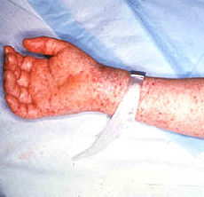
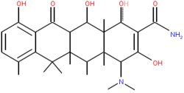
Tetracyclines
Drugs: Doxycycline, minocycline tetracycline, Tygacil (Tigecycline)
MOA: protein synthesis inhibitor at 30S ribosome → bacteriostatic
Treat:
DOC for tick borne diseases: Rickettsia
Spirochetes (helico pylori)
Plasmodium (malaria)
some community MRSA (soft tissue infections)
ADR:
Photosensitivity/Phototoxicity
Discoloration of developing teeth → contraindicated in < 8 y/o
Contraindicated in pregnant women
Chelating with divalent and trivalent cations (Ca 2+)
Rickettsia:
Rocky mountain
spotted fever

